Slide 1
Initiation Dynamics of Rotating Detonation Engines using C₂H₄-O₂ Mixtures
28th International Colloquium on the Dynamics of Explosions and Reactive Systems
University of Naples Federico II. Napoli, Italy
June 19th – 24th
S.F. Connolly-Boutin¹, M. Ghali², R. Gilot², J. Loiseau³, A. Higgins², C.B. Kiyanda¹
¹ Dept. of Mechanical, Industrial and Aerospace Engineering, Concordia University, Montreal, Canada
² Dept. of Mechanical Engineering, McGill University, Montreal, Canada
³ Dept. of Chemistry and Chemical Engineering, Royal Military College, Kingston, Canada

Slide 2
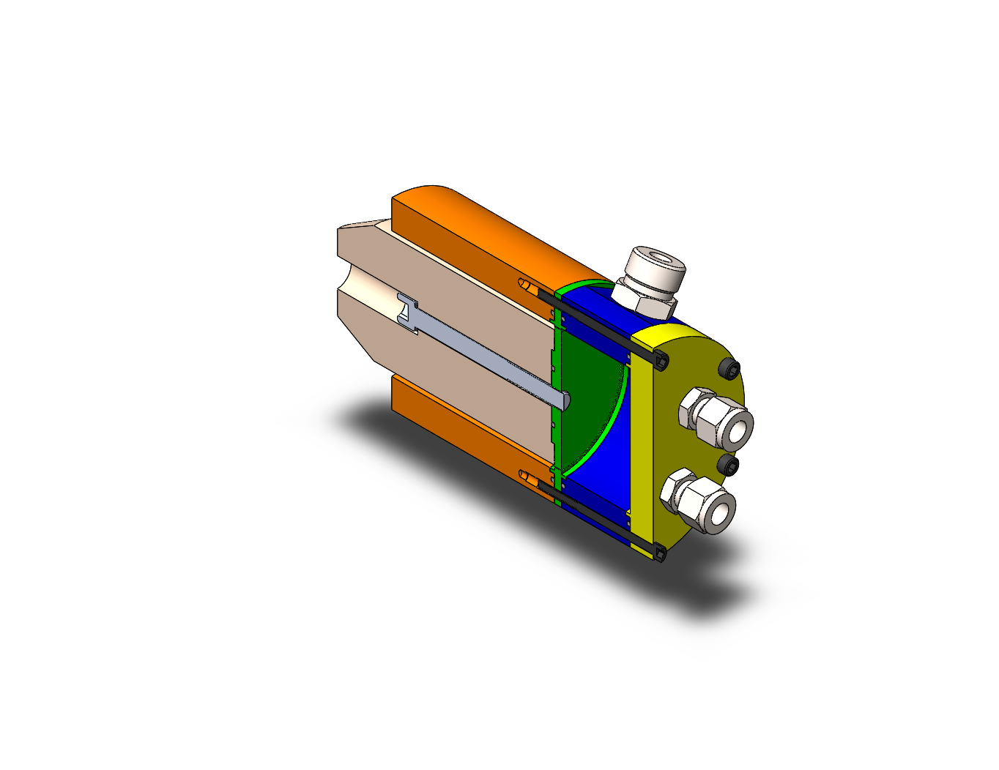
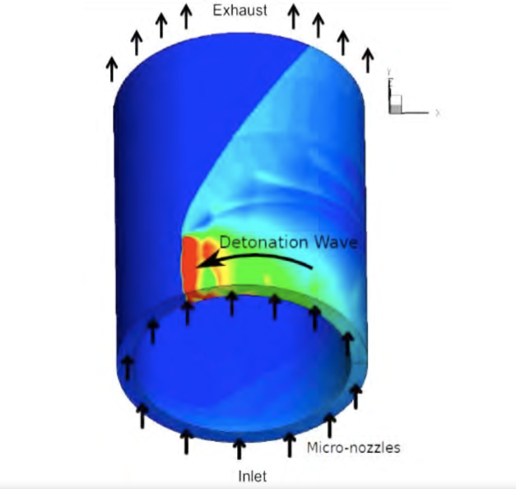
What’s a Rotating Detonation Engine?
Annular combustion chamber
Combustion occurs through (one or more) continuously rotating detonation wave(s)
Detonation is self-pressurizing, unlike in constant pressure rocket combustors

Slide 3
Why Do We Want An RDE At All?
Advantages:
Theoretically more thermodynamically efficient
Self-pressurizing reduces or eliminates the need for pre-compression
Can be used at all velocities (unlike ramjet, scramjet, …)
Unsteady combustion phenomenon (detonation wave), but steady enough to design a nozzle (unlike pulse detonation engines, pulse jets,...)

Slide 4
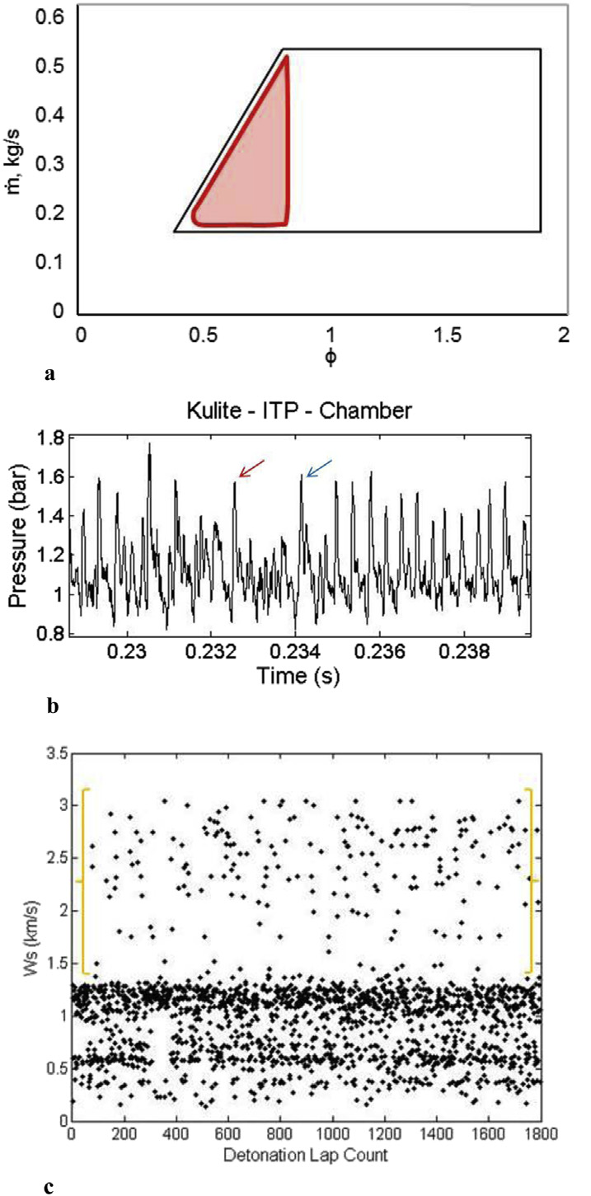
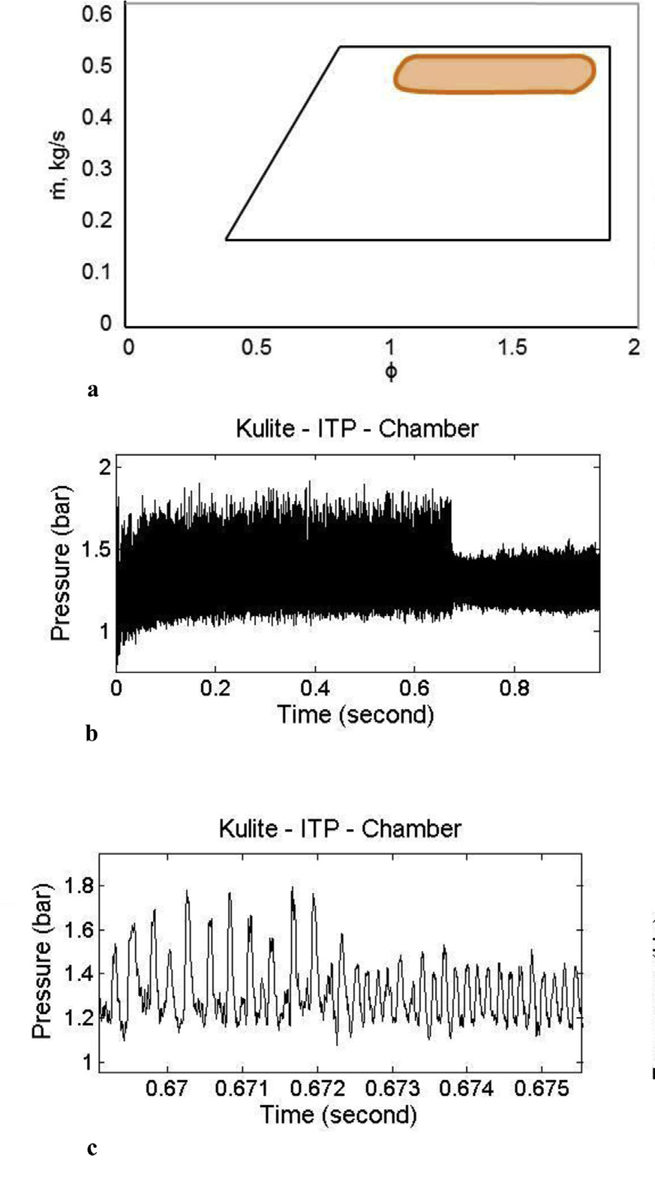
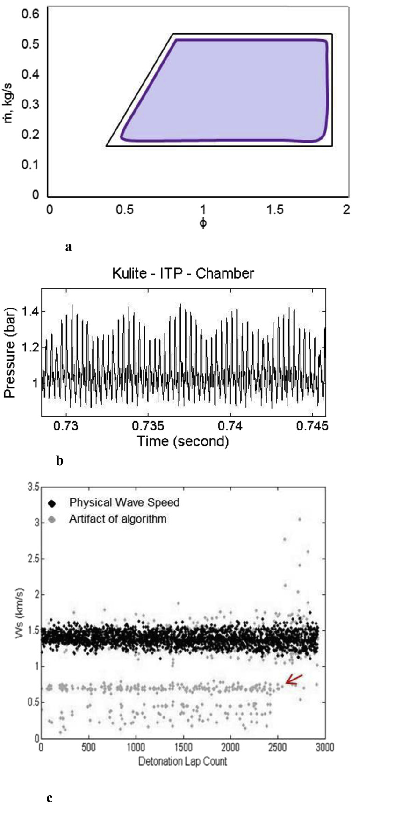
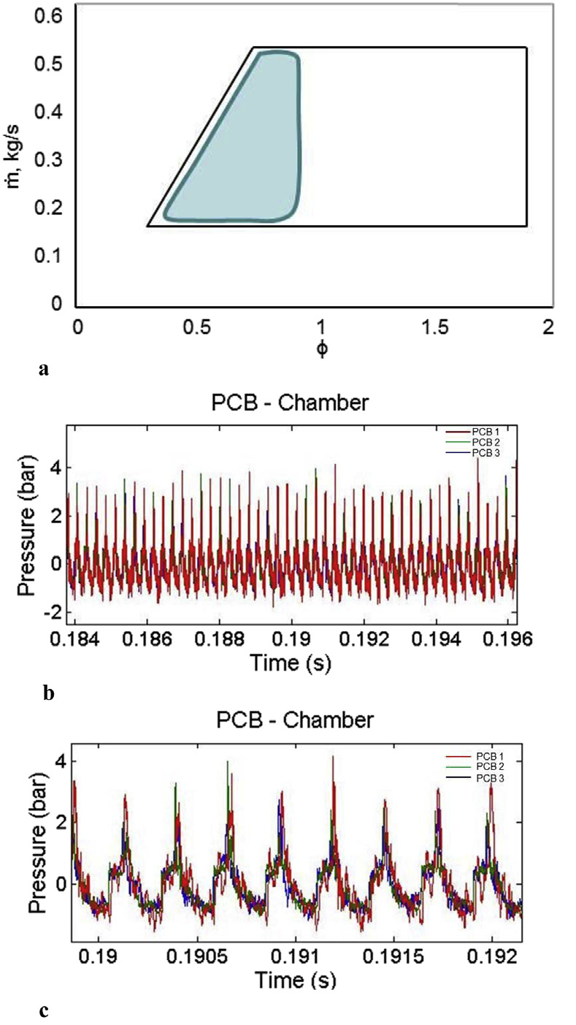
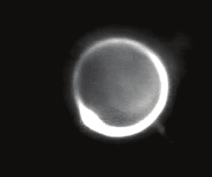
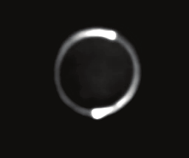
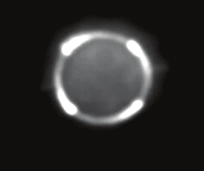
RDE Operation and Stability Regions
Two broad classes of operating modes:
Classical “co-rotating”
Clapping/counter-rotating
Number and direction of detonation waves present in the annulus can vary
Equivalence ratio, fuel mixture properties and mass flow rate impact the operating mode and the presence of instabilities.
Adapted from figs 7 – 10, Anand et al. IJHE, 2015.
Adapted from Stechman, PhD Thesis, Purdue University, 2017

Slide 5


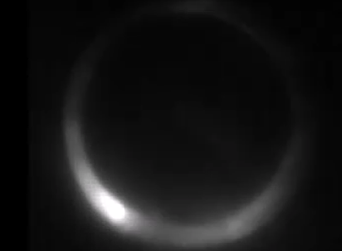
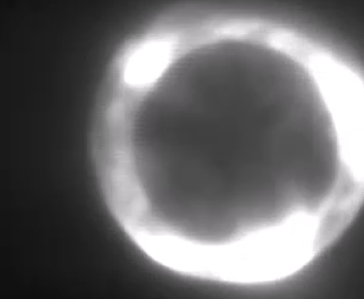
Question
Does the ignition energy impact the operation mode of RDEs?

Slide 6
RDE Operation and Stability Regions
Can we predict when each mode is possible/stable?
How do detonation parameters or parasitic combustion impact RDE stability?
How does the wave mode affect propulsive and thermodynamic efficiencies?
Adapted from figs 7 – 10, Anand et al. IJHE, 2015.
Adapted from Stechman, PhD Thesis, Purdue University, 2017

Slide 7
RDE Operation and Stability Regions
Can we predict when each mode is possible/stable?
How do detonation parameters or parasitic combustion impact RDE stability?
How does the wave mode affect propulsive and thermodynamic efficiencies?
What is the critical initiation energy in an RDE flow field?
Adapted from figs 7 – 10, Anand et al. IJHE, 2015.
Adapted from Stechman, PhD Thesis, Purdue University, 2017

Slide 8
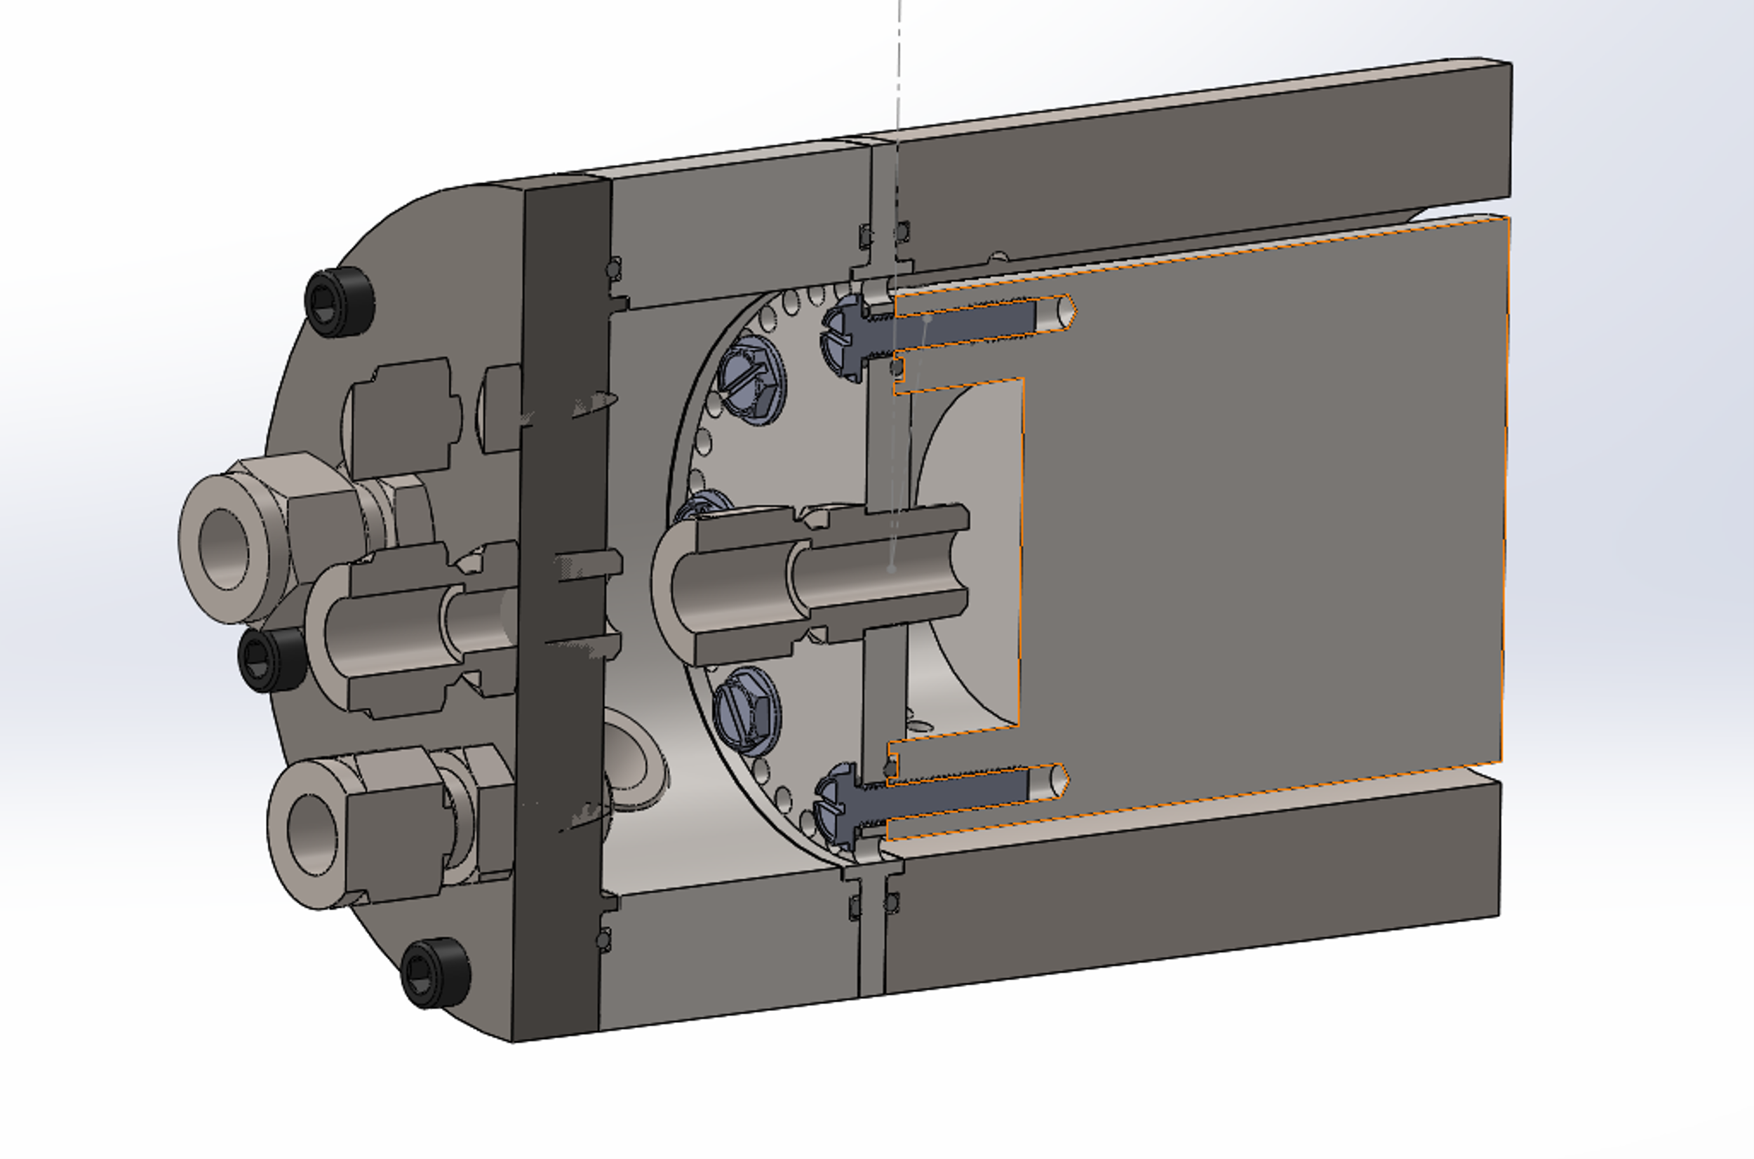
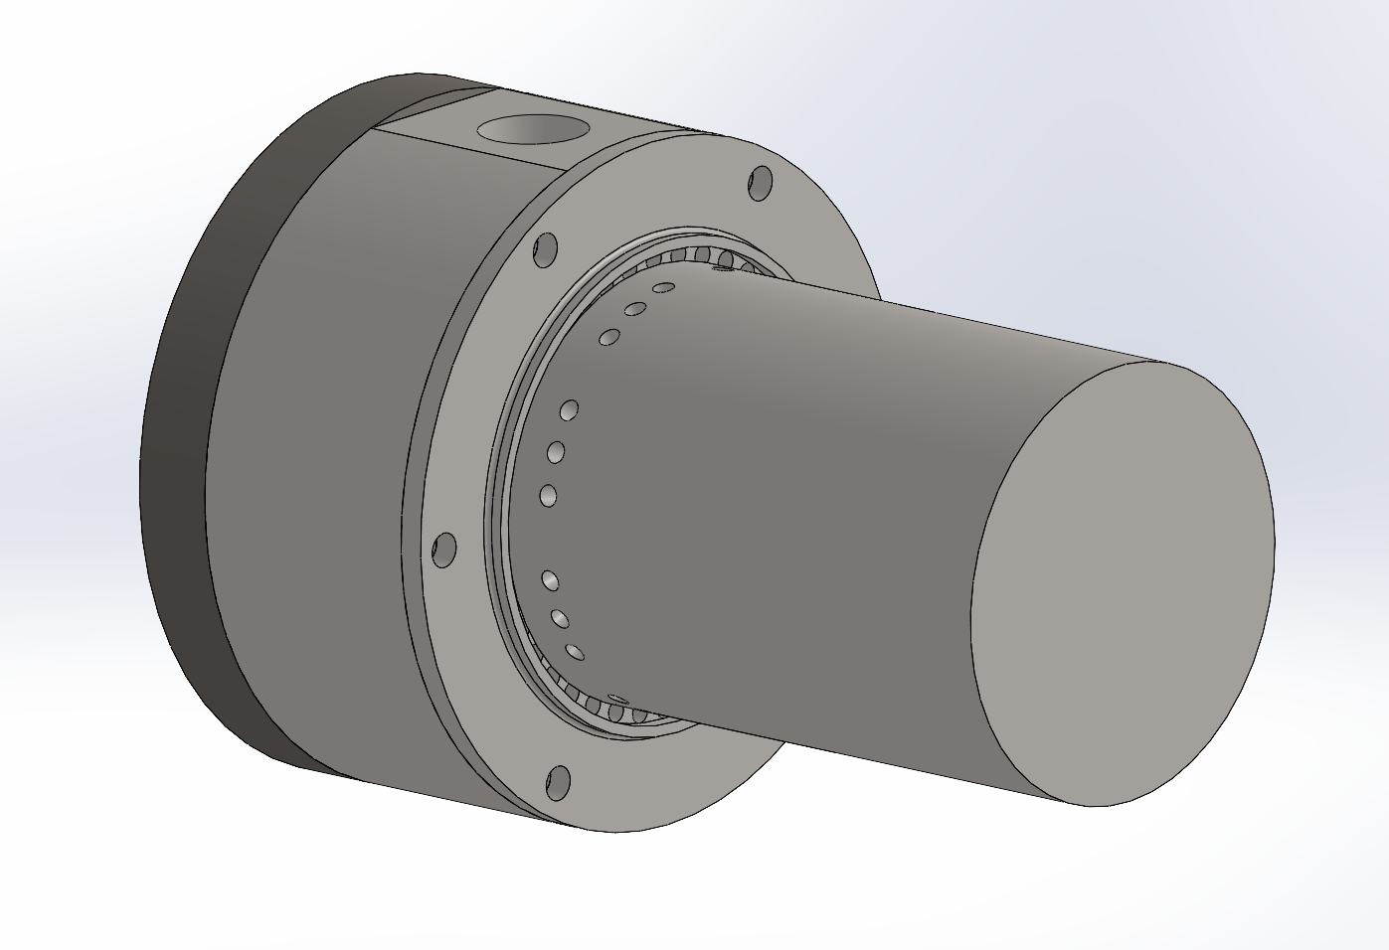
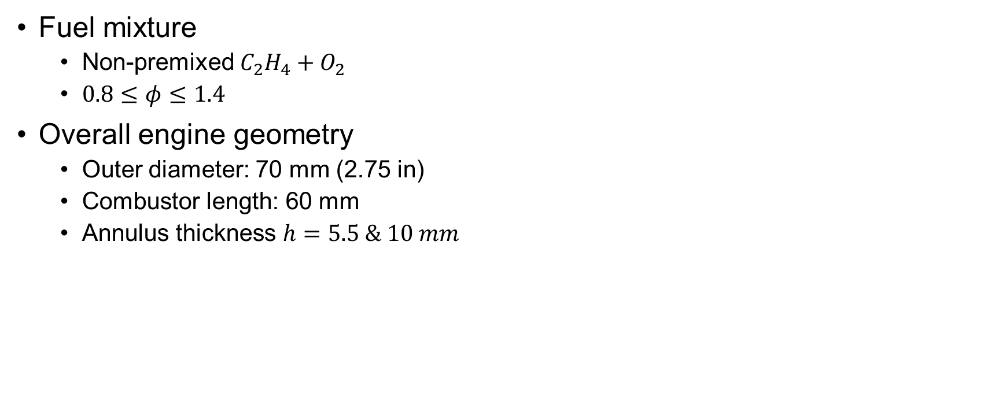
Experiment Description
Fuel mixture
Non-premixed $C_{2}H_{4}+O_{2}$
$0.8≤φ≤1.4$
Overall engine geometry
Outer diameter: 70 mm (2.75 in)
Combustor length: 60 mm
Annulus thickness $h=5.5 \& 10 mm$
Oxidizer
Fuel

Slide 9
Engine Configurations
Oxidizer
Non-premixed, Axial + Radial with standoff
Non-premixed, Axial + Radial impinging jets (“rook”)
Fuel

Slide 10
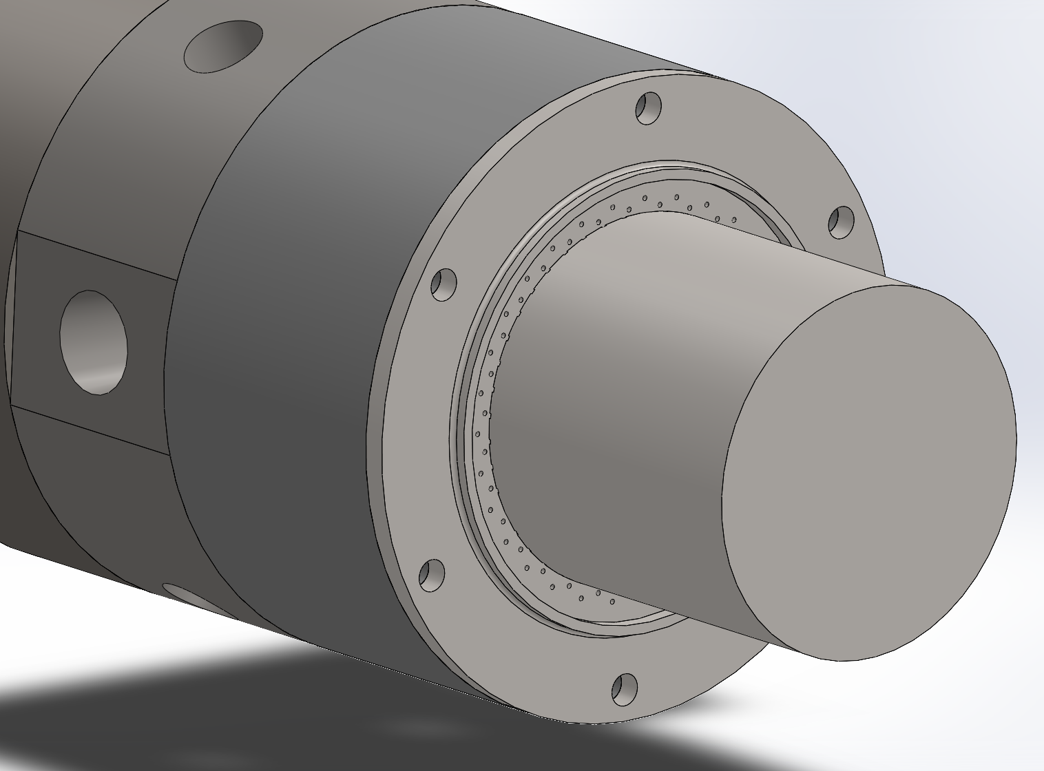
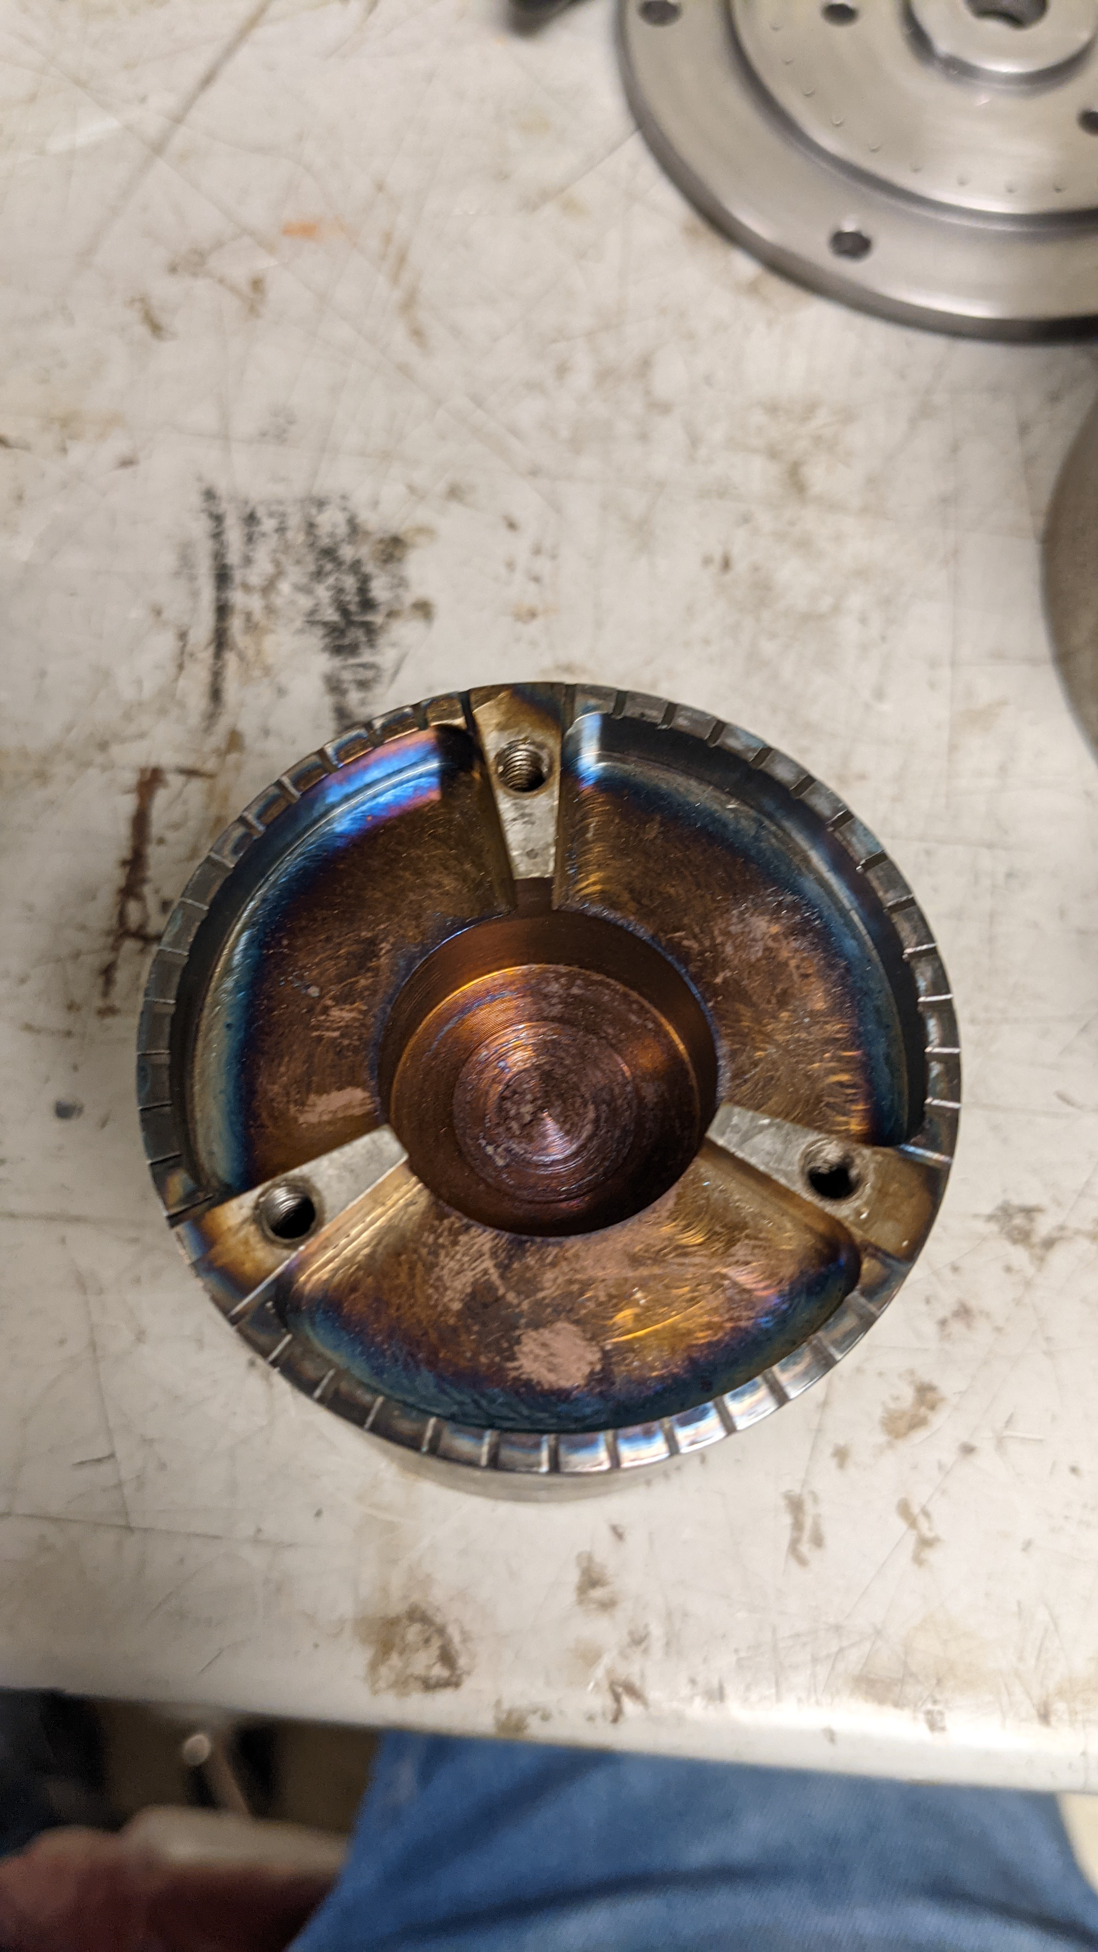
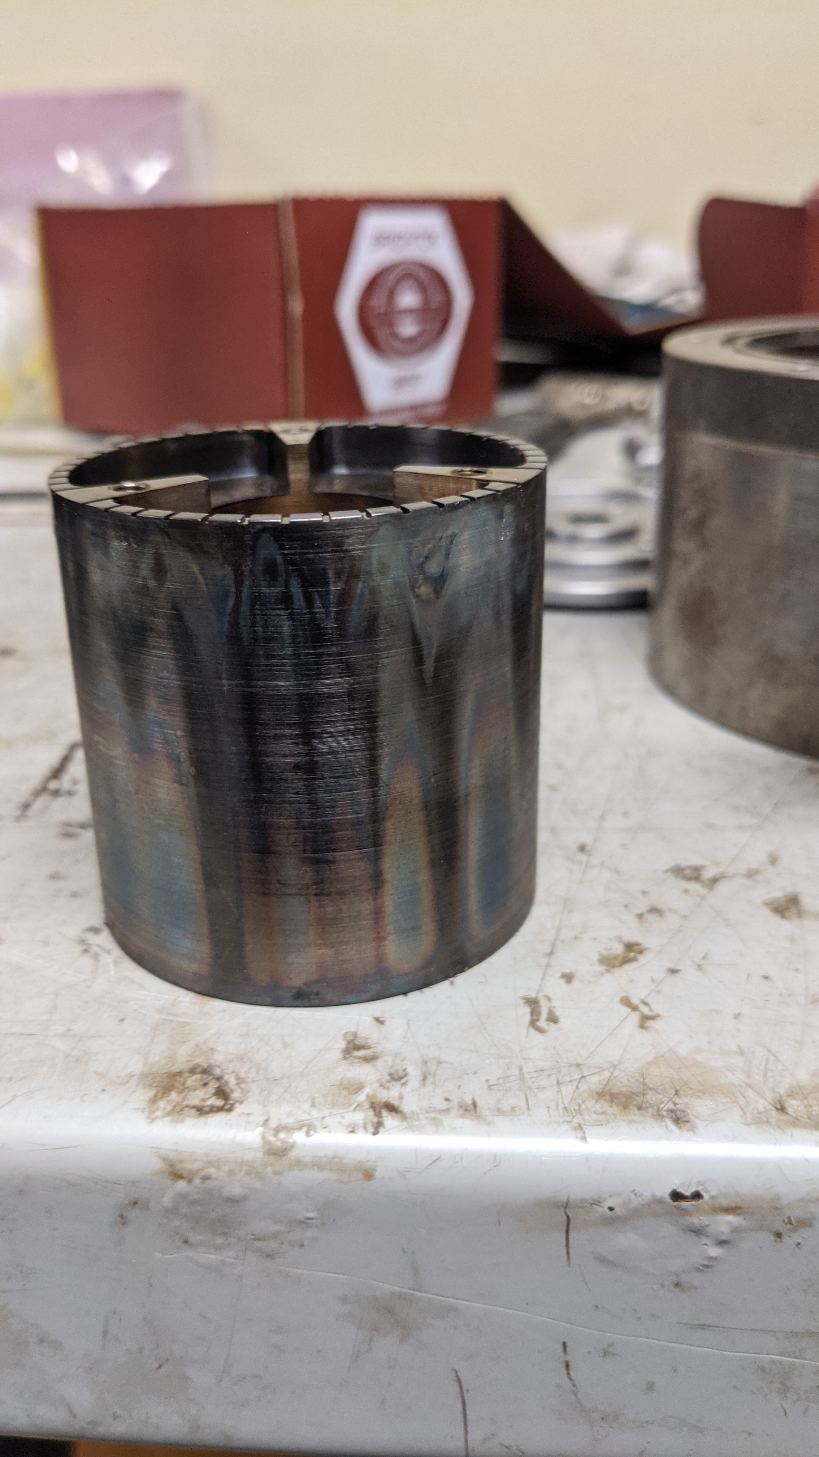
Engine Configurations
Non-premixed, Axial + Radial with standoff
Non-premixed, Axial + Radial impinging jets (“rook”)

Slide 11
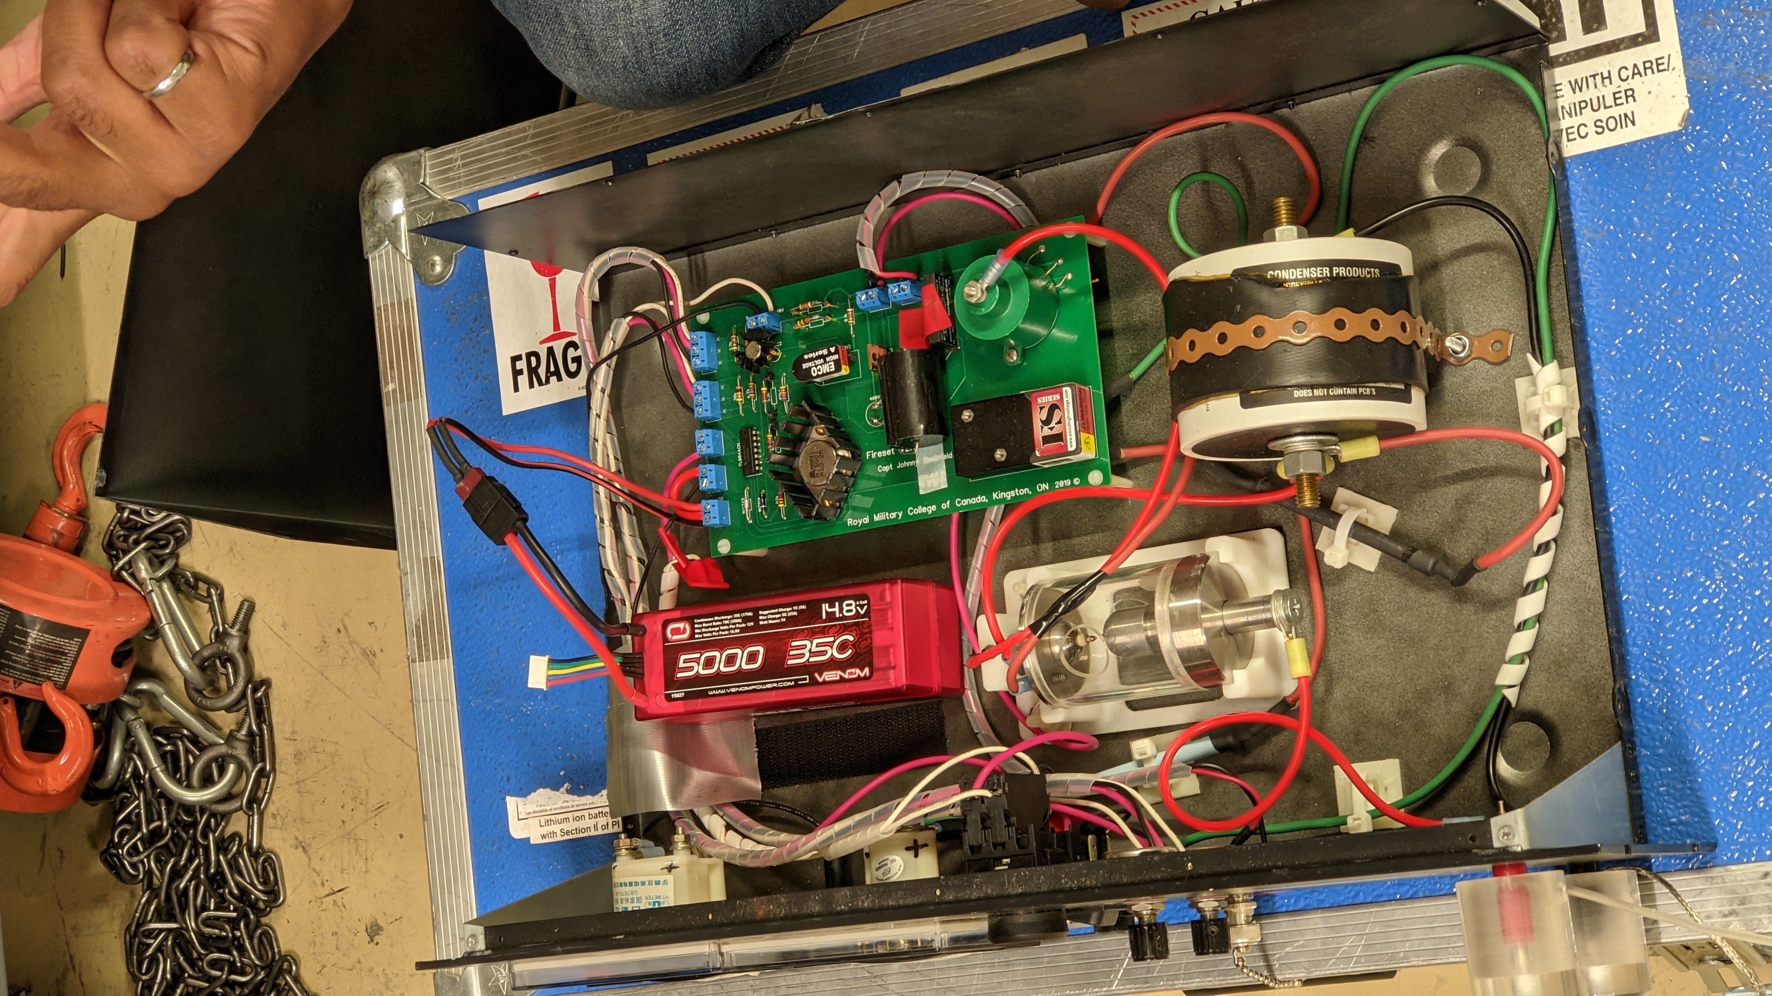
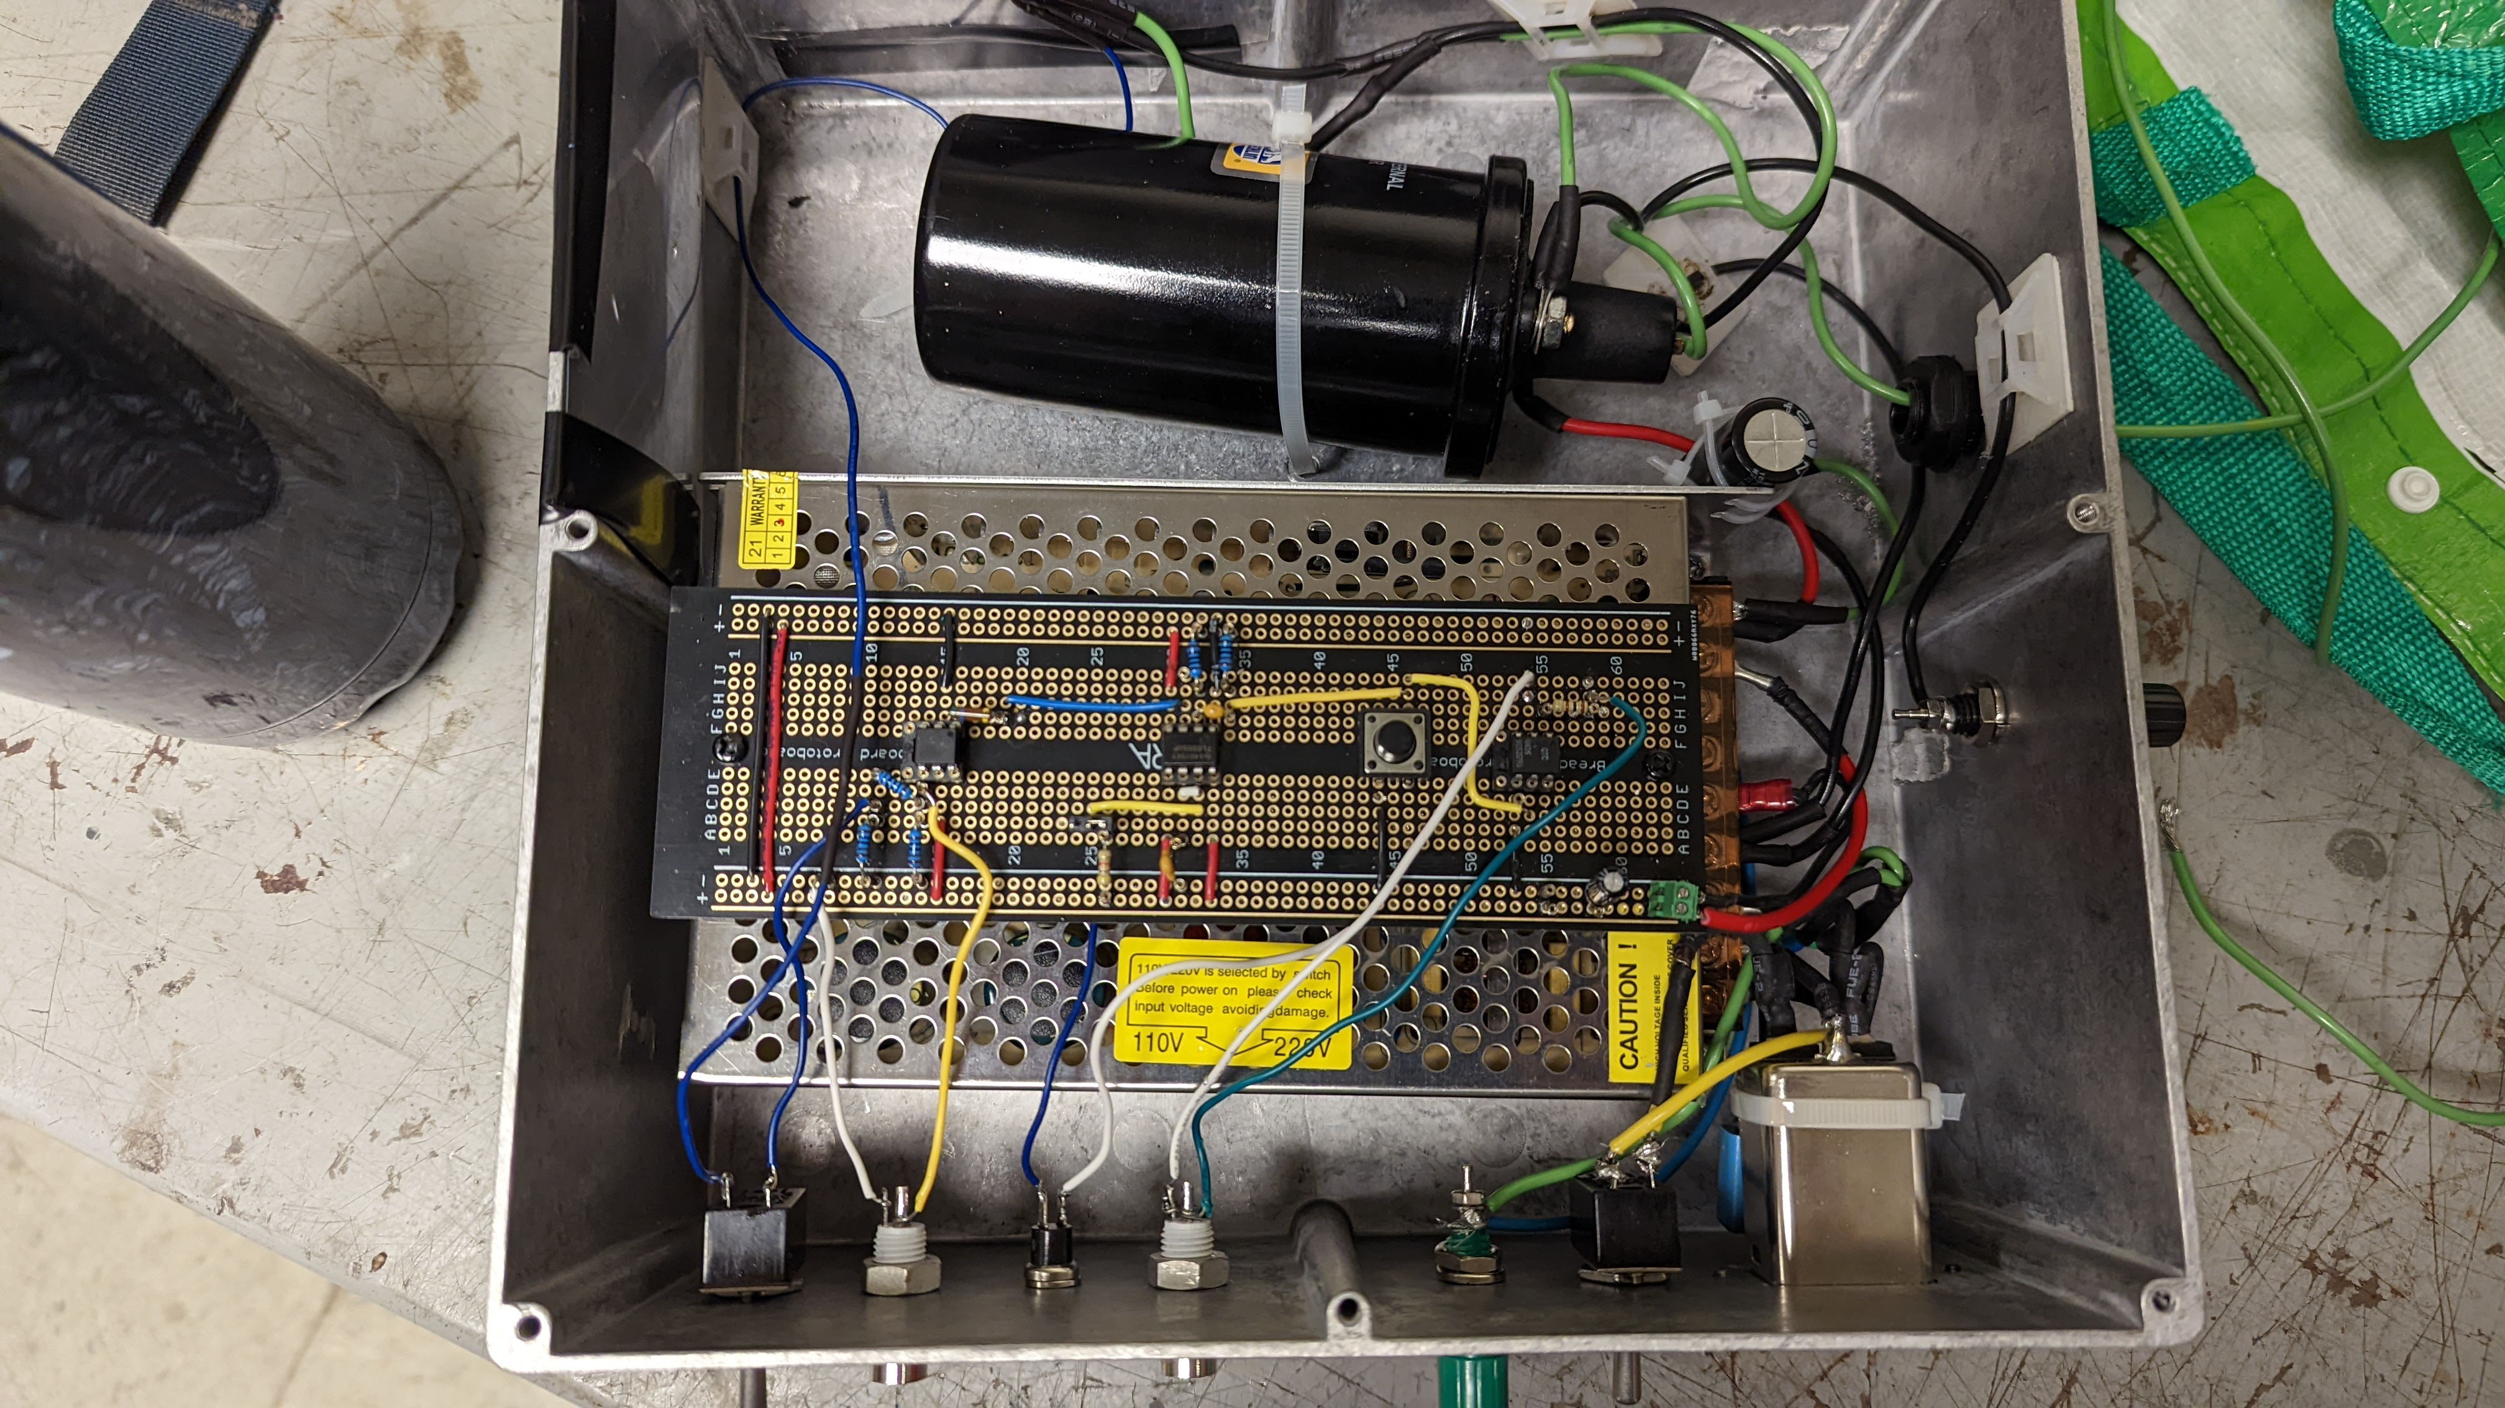
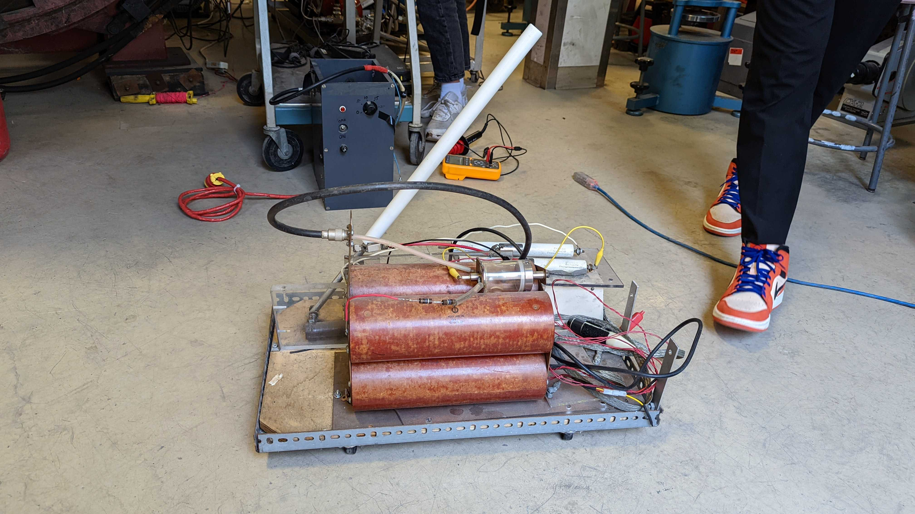
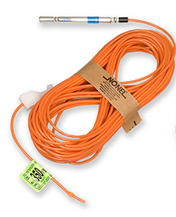
Ignition Energy
Electric
10-100 mJ
1-4 J
≥50 J
Automotive/Coil-based
Non-Electric
Capacitive discharge

Slide 12
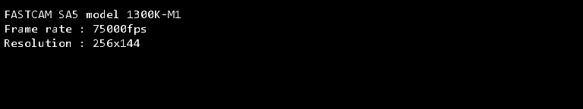
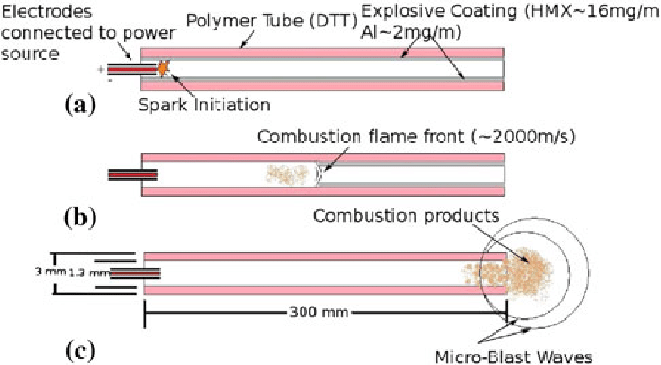
High-Energy Non-Electric Ignition
Non-electric PTA-based ignition system
Ignition energy ~1-4 J
Initiated via shotgun primer
Image from Dyno Nobel
Adapted from Samuelraj et al. 2013
Non-electric ignition

Slide 13
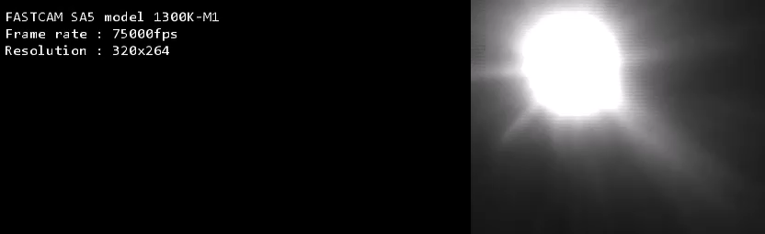
High-Energy Electric Ignition
Spark gap-based ignition system
Spark energy ~1 J (up to 4 J)
High voltage power supply module
xx µF Capacitor
Battery
Spark gap
Low-energy ignition circuit
High energy ignition

Slide 14
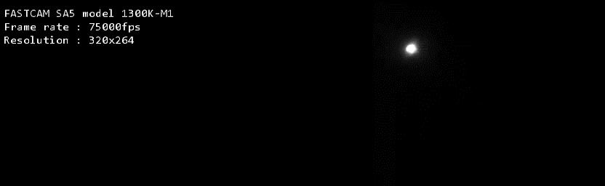
Low-Energy Ignition
Automotive ignition system
Spark energy ~100 mJ
Automotive spark
Single cycle timer
Low-energy ignition circuit
Low energy ignition

Slide 15

Non-Electric Ignition Behaviour
RDE behaviour sustained
No discernable DDT: nearly direct initiation
3 wave mode with changes in rotational direction
Nonelectric initiator
Rook-style plug

Slide 16

Non-Electric Ignition Behaviour
Ignition not captured, but a long DDT even occurs.
High energy ignition leading to clapping mode.
Nonelectric initiator
Rook-style plug

Slide 17
High-Energy Ignition Behaviour
Short DDT time (70 µs)
DDT leading to two counter rotating waves shortly after ignition
High energy igniter
Rook-style plug

Slide 18
Low-Energy Ignition Behaviour
Long gap between spark and appearance of detonation (770 µs) indicating a DDT event.
Single wave appears after DDT event.
Low energy igniter
Axial, radial standoff

Slide 19
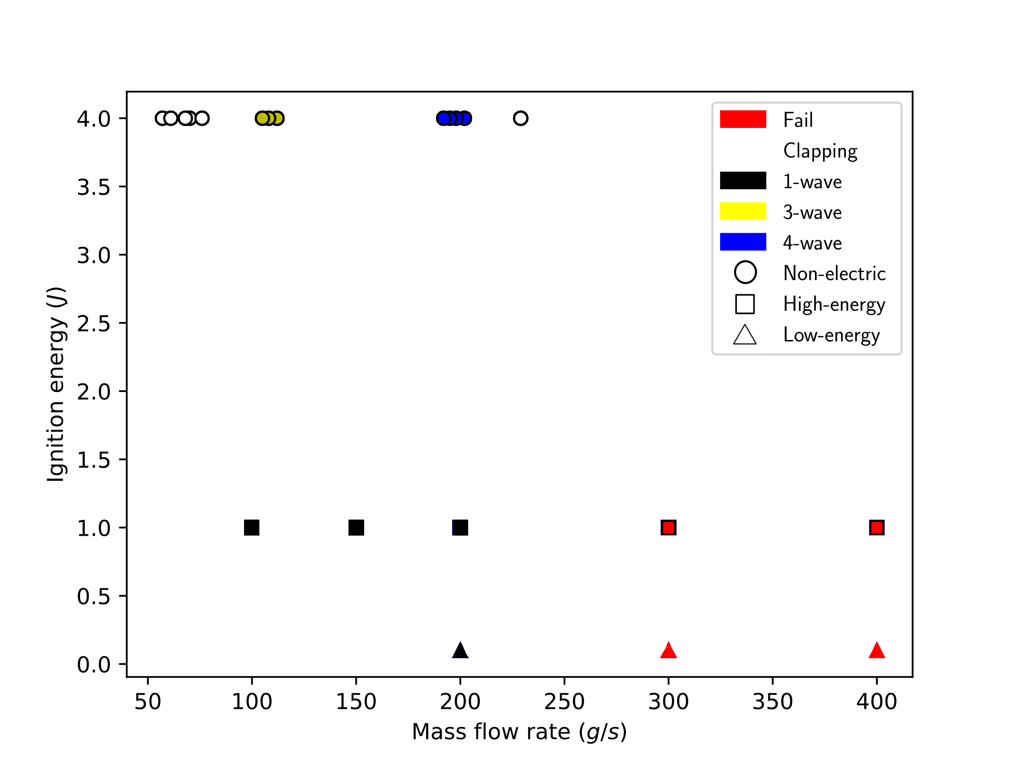
Full Data Set

Slide 20
Conclusions and Upcoming Work
Low-energy electric ignition leads to delayed ignition (possible DDT) of a single wave mode.
High-energy ignition leads to prompt initiation of clapping mode.
High-energy nonel ignition leads to prompt initiation of clapping mode followed by multi-wave transitions.
Sustained operation failures investigated with new injection system (issue related to injector choking and pressure drop)

Slide 22
RDE Operation and Stability Regions
Number and direction of detonation waves present in the annulus can vary
Different instability modes have been observed
Equivalence ratio, fuel mixture properties and mass flow rate have been shown to impact the presence of instabilities
Can we predict the operating mode of an RDE?
Adapted from figs 7 – 10, Anand et al. IJHE, 2015.
Adapted from Stechman, PhD Thesis, Purdue University, 2017

Slide 23
Ignition of RDEs
Ignition energy influences the initial wave dynamics inside the engine.
Low energy ignition leading to a single wave after a long delay (~773 µs) indicating a DDT event
High energy ignition leading to a clapping mode on ignition. (~65 µs)

